Slide 1
The Savings Syndicate
An innovative in way to have access to your dream
Group 13.
Benjamin, Bruno, Mauricio, Ravi
Notes:
Hi all,
We are the Savings Syndicate, and we will help you to get your home faster

Slide 2

The dream of having your own home
It’s…
An asset
A milestone in life
A dream
A way to build wealth
Provides financial security and stability
Notes:
For many, having you own home is a dream, but it’s even more than that, it provider financial security and stability

Slide 3
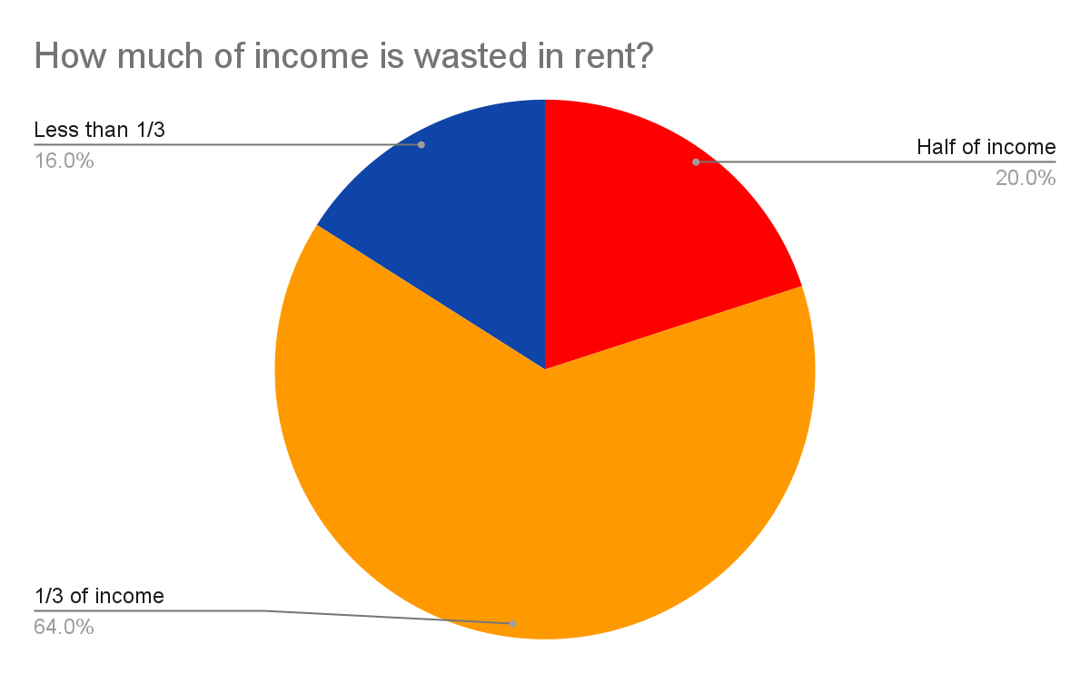
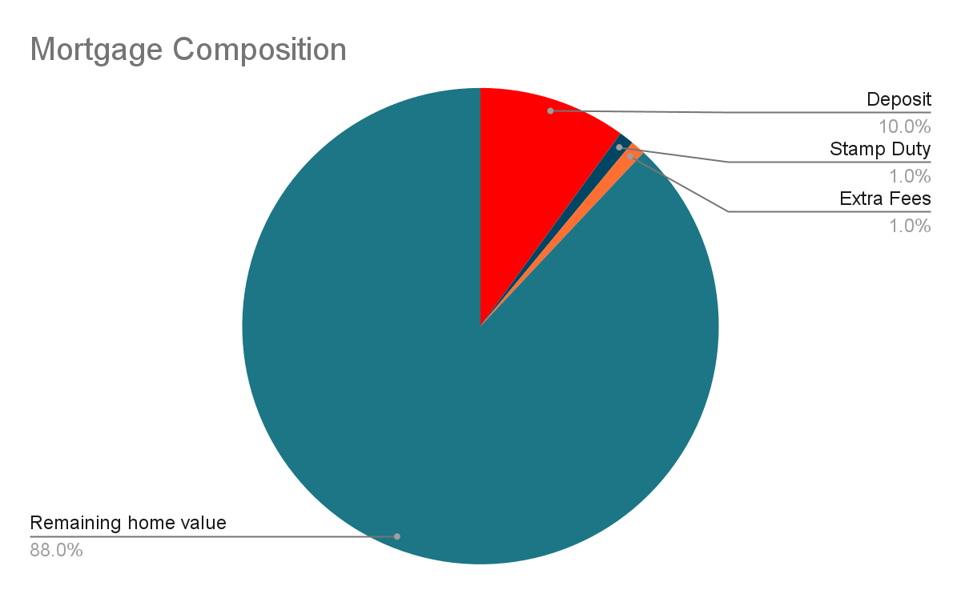
More than 5 years struggling to buy
Notes:
Unfortunately, this dream is is only attainable by the economically privileged now a days.
This data is from Dublin. There, a good portion of the families spend more than half of their income in rent
That makes very challenging to accumulate the 10% deposit needed for a mortgage

Slide 4
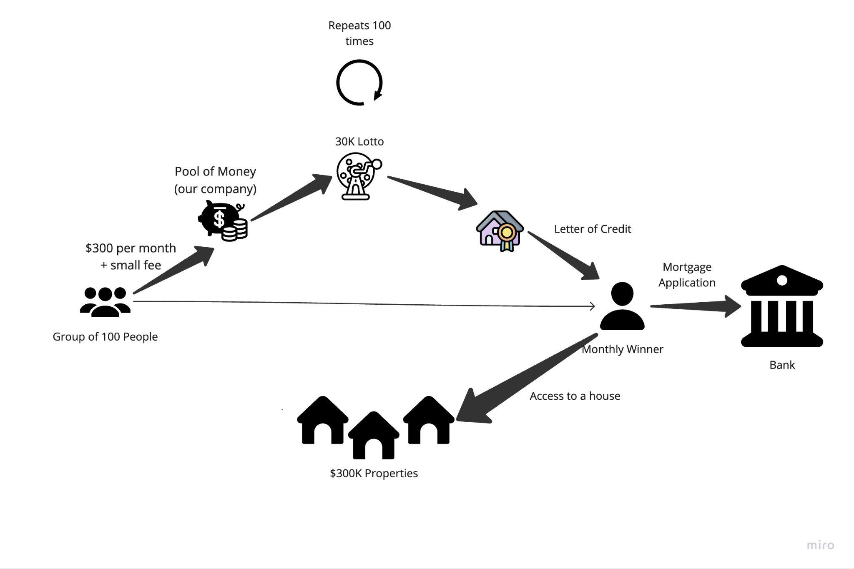
Our Solution
Notes:
We want to build a pools of people interested in buying a house
Here we have a group of 100 people interested in buying a 300k property
They can pay 300 per month plus a small fee for our company, then, we run a raffle monthly that gives for one of those people a letter of credit and a chance to apply for a mortgage and have early access to a property
This repeats until everyone in the pool have a house

Slide 5
What is in for the bank?
Backlog of 100 people that will apply for a mortgage
Customer acquisition
Earlier application
Notes:
The banks can also win, that pool of 100 people is a pipeline of 100 potential mortgage appliers, that can also drive up customer acquisition and earlier applications for a mortgage. Now for the Demo

Slide 6
Demo

Slide 7
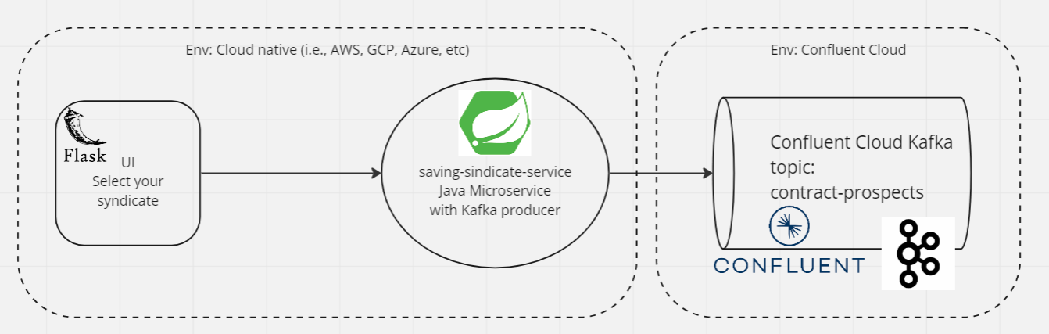
Technical Solution

Slide 8
Sources
https://www.irishmirror.ie/lifestyle/homes-and-property/ireland-house-prices-how-much-26794148
https://www.newstalk.com/news/one-fifth-of-dublin-tenants-spending-over-half-their-income-on-rent-1225319

